Slide 1

Collaboration Diagram
Submitted by
Udit Sharma
11602121

Slide 2
Types of Interaction diagrams
There are two types of interaction diagrams:
Sequence diagrams:
emphasize the order / Sequence or
concurrency of the interactions.
Collaboration diagrams:
emphasize the interacting objects.

Slide 3
Collaboration Diagrams
Dynamic behavior of objects can be represented by collaboration diagrams.
The transformation from a sequence diagram into a collaboration diagram is a bi-directional function.
The difference between sequence diagrams and
collaboration diagrams is that collaboration
diagrams emphasize more the structure than the sequence of interactions.
Within sequence diagrams the order of interactions
is established by vertical positioning whereas in
collaboration diagrams the sequence is given by numbering the interactions.

Slide 4
Collaboration Diagram Definition
Collaboration Diagrams captures dynamic behavior of the objects in the system (message-oriented).
They are very useful for visualizing the relationship between objects collaborating to perform a particular task.
Their purpose is to:
Model flow of control
Illustrate coordination of object structure and control

Slide 5
Collaboration Diagram Elements
There are three primary elements of a collaboration diagram:
Objects
Links
Messages

Slide 6

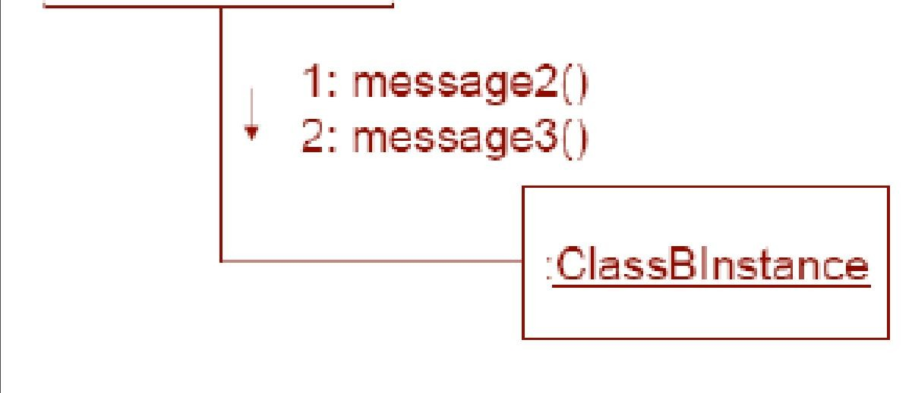
What it represents ?
Collaboration Diagrams illustrate object interactions in a graph or network format.

Slide 7
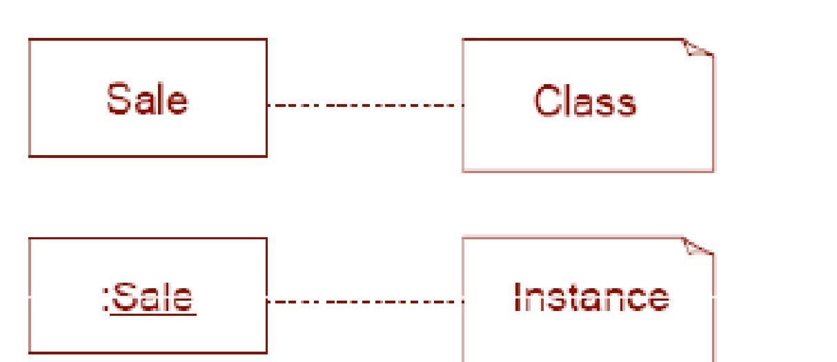

Notations used for Collaboration Diagrams
Objects
An object is represented by an object symbol showing the name of the object and its class underlined, separated by a colon:
Object_name : class_name
\An instance name can be used to uniquely identify the instance.

Slide 8
Links
Links connect objects and actors and are instances of associations and each link corresponds to an association in the class diagram
Links are defined as follows:
A link is a relationship among objects across which messages can be sent. In collaboration diagrams, a link is shown as a solid line between two objects.

Slide 9
Messages
Objects collaborate by communicating (passing messages) with one another in order to work together
A message is a communication between objects that conveys information In collaboration diagrams, a message is shown as a labeled arrow placed near a link.
The message is directed from sender to receiver

Slide 10
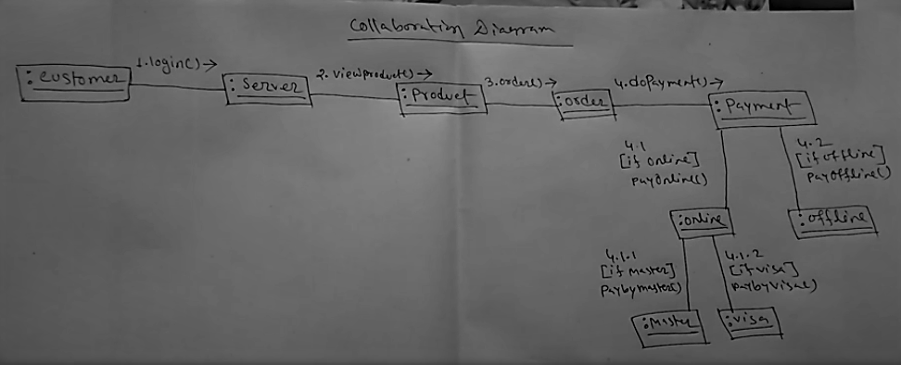

Slide 11
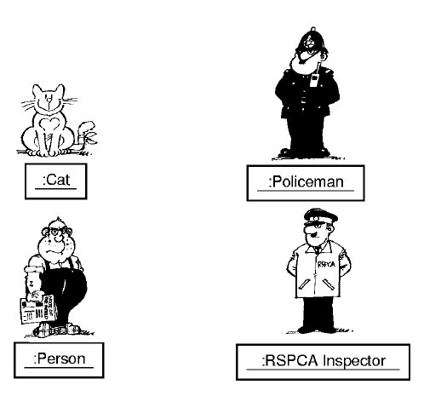
Fun Example Objects

Slide 12
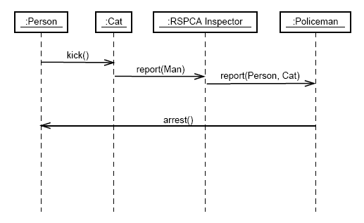
Fun Example Sequence diagram

Slide 13
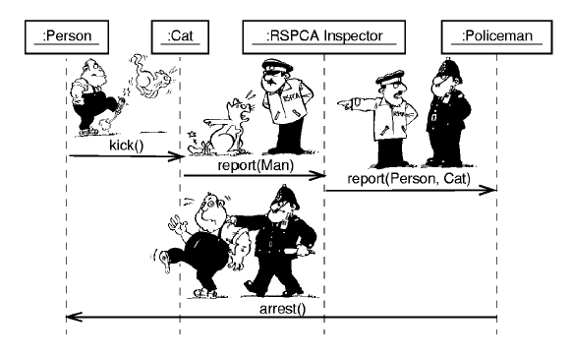
Fun Example Sequence diagram

Slide 14
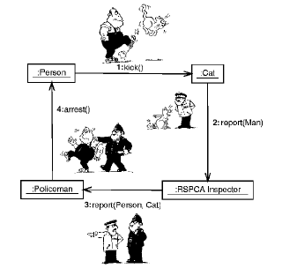
Fun Example Collaboration Diagram

Slide 15
SEQUENCE DIAGRAMS | COLLABORATION DIAGRAMS
The sequence diagram is used to visualize the sequence of calls in a system that is used to perform a specific function. | The collaboration diagram is used to visualize the organization of the objects and their interaction.
The sequence diagram are used to represent the sequence of messages that are flowing from one object to another. | The collaboration diagram are used to represent the structural organization of the system and the messages that are sent and received.
The sequence diagram is used when time sequence is main focus. | The collaboration diagram is used when object organization is main focus.
The sequence diagrams are better suited of analysis activities. | The collaboration diagrams are better suited for depicting simpler interactions of the smaller number of objects.

